Slide 1
Background information – Remove this slide before presenting
INSTRUCTIONS TO USE THIS PRESENTATION
This is a general presentation of the eCAN Joint Action. If you, as an eCAN partner, need to present this project in a conference, congress or other public event, you can use this presentation and adapt it to match your needs.
Points this presentation addresses:
Front cover for information of title, event and authors
Introduction and background
What is eCAN?
Why is this project needed?
Objectives
Methods
Work Packages
How we plan to do it?
Back cover
Every section offers diferent designs and some of them provide slightly different information. You are free to choose the slides you like the most and organise the presentation as you wish.
If you add or change information, please try to keep the same font and sizes in headings, subheadings and text. Copy past the text box from other slides and KEEP THE ORIGINAL DESIGN.
If you have any questions or need some help, please contact the Communication and Dissemination team: Elisa (epinon@iconcologia.net) and Edgar (ehans@iconcologia.net)

Slide 2
EU4Heatlh Programme 2021
Grant Number 101075326
TITLE
Subtitle
Author(s) of the presentation
Funded by the European Union. Views and opinions expressed are however those of the author(s) only and do not necessarily reflect those of the European Union or HaDEA. Neither the European Union nor the granting authority can be held responsible for them.

Slide 3
EU4Heatlh Programme 2021 Grant Number 101075326
Funded by the European Union. Views and opinions expressed are however those of the author(s) only and do not necessarily reflect those of the European Union or HaDEA. Neither the European Union nor the granting authority can be held responsible for them.

Slide 4
EU4Heatlh Programme 2021 Grant Number 101075326
Funded by the European Union. Views and opinions expressed are however those of the author(s) only and do not necessarily reflect those of the European Union or HaDEA. Neither the European Union nor the granting authority can be held responsible for them.

Slide 5
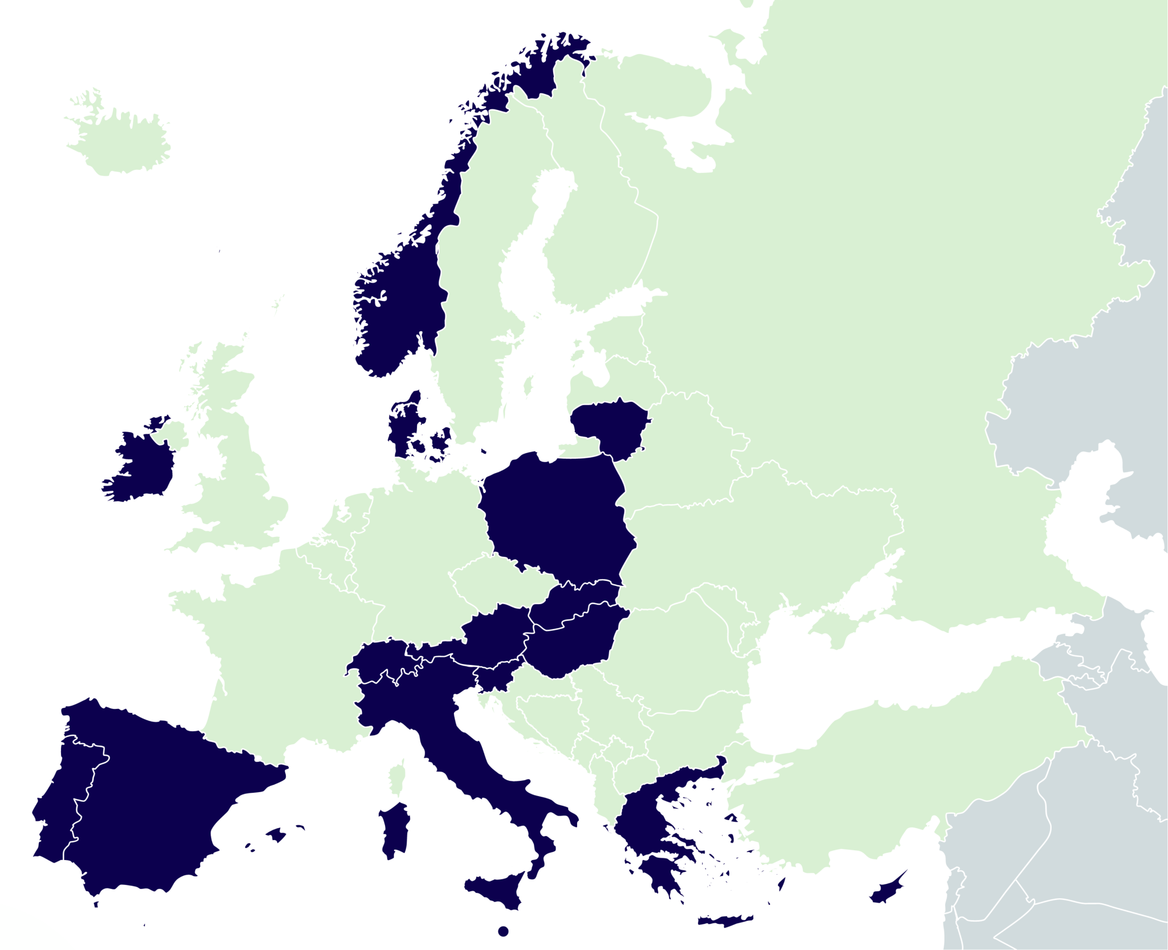
What is eCAN?
The eCAN Joint Action aims to provide a framework of recommendations for the integration of telemedicine and remote monitoring in health care systems.
The objective is to reduce cancer care inequalities across the European Union, particularly for cross-border emergencies and health crises, such as COVID-19.
35
2 years
16
5M
organisations
2022-2024
countries
EUR budget
1

Slide 6
What is eCAN?
The eCAN Joint Action aims to provide a framework of recommendations for the integration of telemedicine and remote monitoring in health care systems.
16
35
countries
organisations
2 years
5M
2022-2024
EUR budget
1

Slide 7
Why is this project needed?
The context in the EU
Over 2.7 million new cancer cases are diagnosed every year in the EU. In fact, cancer is the second leading cause of mortality in the EU after cardiovascular diseases.
Projection
It is expected that, without a strong action, the number of diagnosed cancer cases will increase by a fourth by 2035.
Why eCAN?
To increase capabilities for cancer prevention and care provision by telemedicine.
2

Slide 8
Specific Objectives
Improve the response in front of epidemic and in crisis situations, where isolation of patients will be a key element.
Increase the communication between cancer services during an emergency situation and health crises.
Improve knowledge and preparedness of the cancer care workforce in the virtual consultation of patients in areas that are difficult-to-reach.
Enhance knowledge-sharing among healthcare professionals.
Enable cross-border cooperation and uptake of results.
3

Slide 9
Objectives
Improve the response in front of epidemic and in crisis situations, where isolation of patients will be a key element.
Increase the communication between cancer services during an emergency situation and health crises.
Improve knowledge and prepared﻿ness of the cancer care workforce in the virtual consultation of patients in areas that are difficult-to-reach.
Enhance knowledge-sharing among healthcare professionals.
Enable cross-border cooperation and uptake of results.
3

Slide 10
Specific Objectives
Reduce cancer care inequalities across the European Union, particularly for cross-border emergencies and health crises, such as COVID-19
Improve the response in front of epidemic and in crisis situations, where isolation of patients will be a key element.
Increase the communication between cancer services during an emergency situation and health crises.
Improve knowledge and prepared﻿ness of the cancer care workforce in the virtual consultation of patients in areas that are difficult-to-reach.
Enhance knowledge-sharing among healthcare professionals.
Enable cross-border cooperation and uptake of results.
3

Slide 11
Work Packages
WP1
WP2
WP3
WP4
Coordination
Communication
Evaluation
Sustainability
Sciensano, the Belgian Institute for Health, leads the Coordination Work Package, ensuring an effective management of all administrative and budgetary requirements.
The Institut Català d’Oncologia (Catalan Institute of Oncology, in Spain) leads the communication area and takes care of all work related to the dissemination of the eCAN’s activities, updates, results and recommendations.
The Maria Sklodowska-Curie National Research Institute of Oncology (MSCNRIO, in Poland) heads the Evaluation work area, that will assess whether eCAN is implemented as planned.
The Gesundheit Österreich GmbH, GÖG (The Austrian National Public Health Institute) manages this work area dedicated to develop a roadmap towards a sustainable implementation of eHealth initiatives in cancer care.
4

Slide 12
Work Packages
WP5
WP6
WP7
WP8
Legal, ethical framework and cybersecurity
Stakeholders engagement
Telemonitoring
Teleconsultation
The Regina Elena National Cancer Institute (IFO-IRE, in Italy) leads the pilots that address the role of teleconsultation in rehabilitation treatment and psychological support for cancer patients.
IFO-IRE is also in charge of this WP that will propose guidelines to better address patients’ rights, equality of access, protection of privacy and health data protection.
The National eHealth Authority of Cyprus (NeHa), along with affiliated entities and collaborators, leads Work Package 7, focused on telemonitoring solutions used for cancer patients worldwide.
The 3rd Regional Health Authority of Macedonia (3rd RHA) is the Greek institution responsible of leading this work package, focused on identifying stakeholders across the EU and boosting their engagement.
5

Slide 13
How is the project structured?
FOUR TRANSVERSAL WORK PACKAGES
WP1
WP2
WP3
WP4
Coordination
Evaluation
Sustainability
Communication
Leaded by
Leaded by
Leaded by
Leaded by
4

Slide 14
How is the project structured?
FOUR TECHNICAL WORK PACKAGES
WP5
WP6
WP7
WP8
Legal, ethical framework and cybersecurity
Telemonitoring
Stakeholders
engagement
Teleconsultation
Leaded by
Leaded by
Leaded by
5

Slide 15
How we plan to do it?
Our project explores the role of teleconsultation and telemonitoring in a clinical trial focused on telerehabilitation and telepsychological support in different populations of cancer patients.
Patient Reported Outcomes (PRO) and Experien﻿ces (PRE) will be monitored by dedicated telemonitoring systems.
Data security and privacy﻿ protection, along with their challenges and risks, will also be addressed in parallel with the conduct of the study.
6

Slide 16
The eCAN Application
The app counts with questionnaires to track patients' outcomes, experiences, activity and lifestyle. Other indicators, such as quality of life, pain or distress, will also be reported through the eCAN app.
At the same time, smartwatches will be used to automatically collect data on patients' daily activity, sleep quality, heart rate, etc.
Clinicians will collect all this information in a secure web platform that will help them make decisions about patient treatment and care, while also enabling future artificial intelligence (AI) applications.
7

Slide 17
Funded by the European Union. Views and opinions expressed are however those of the author(s) only and do not necessarily reflect those of the European Union or HaDEA. Neither the European Union nor the granting authority can be held responsible for them.
THANKS!
info@ecanja.eu

Slide 18
THANKS!
eCAN Joint Action
CONTACT US:
info@ecanja.eu
eCAN Joint Action
@ecan_ja
@ecan_ja
@ecan_ja
ecanja.eu
@ecan_ja

